Slide 1
5. Introduction to local estimation

Slide 2
Overview
Traditional vs. piecewise SEM
Tests of directed separation
Introduction to piecewiseSEM

Slide 3
5.1 Traditional vs. Piecewise SEM

Slide 4
5.1 Comparison. Traditional vs. piecewise SEM
Variance-covariance | Piecewise
Single (global) variance-covariance matrix estimated | Multiple (local) variance-covariance matrices estimated (one for each endogenous variable)
Simultaneous solution | Multiple solutions
Fit to normal distribution | Incorporates various distributions
Assumes independence | Can model non-independence (blocked, temporal, spatial, etc.)
Latent & composite variables | No latent or composite variables (yet*)
Correlated errors | Only partial correclations (so far*)
Non-recursive (feedbacks) | Only for recursive
Multi-group models | Can estimate random components but no formal test

Slide 5



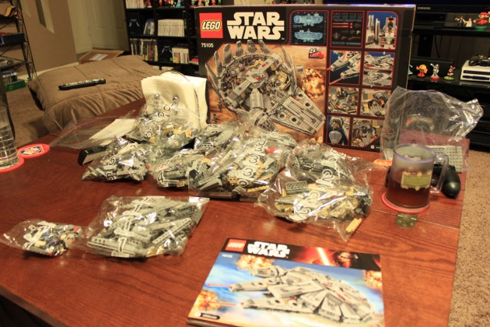
5.1 Comparison. Traditional vs. piecewise SEM
Traditional SEM
Piecewise SEM

Slide 6
5.1 Comparison. Graphs to equations
ζ₂
γ₁₂
x₁
y₂
γ₁₁
β₁₂
y₁
ζ₁
y₁ = γ₁₁x₁ + ζ₁
y₂ = γ₁₂x₁ + β₁₂y₁ + ζ₂

Slide 7
5.1 Comparison. Break this model up
ζ₁
ζ₃
β₁₃
γ₁₁
y₁
y₃
x₁
β₂₃
β₄₃
γ₁₂
y₂
y₄
β₂₄
ζ₄
ζ₂

Slide 8
5.1 Comparison. Break this model up
ζ₁
ζ₃
β₁₃
γ₁₁
y₁
y₃
x₁
β₂₃
β₄₃
γ₁₂
y₂
y₄
β₂₄
ζ₂
ζ₄
ζ₁
ζ₂
γ₁₁
γ₁₂
x₁
y₁
x₁
y₂
2 Simple Linear Regressions

Slide 9
5.1 Comparison. Break this model up
ζ₁
ζ₁
ζ₃
ζ₃
β₁₃
β₁₃
y₁
y₁
y₃
γ₁₁
y₃
γ₁₁
β₂₃
x₁
β₂₃
x₁
β₄₃
β₄₃
γ₁₂
γ₁₂
y₂
y₂
y₄
y₄
β₂₄
β₂₄
ζ₄
ζ₂
ζ₄
ζ₂
y₁
β₁₃
ζ₃
ζ₄
β₂₃
β₂₄
y₂
y₄
y₂
y₃
y₄
β₄₃
1 Simple, 1 Multiple Regression

Slide 10
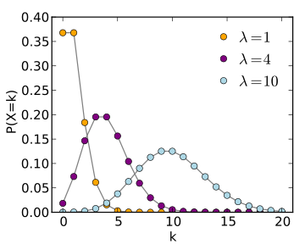
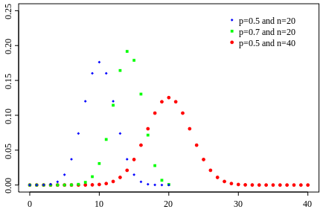
5.1 Comparison. Incorporate new distributions

Slide 11
5.2 Tests of Direction Separation

Slide 12
5.2 Directed Separation. Model fit
Does the model fit the data?
=
Does the model represent the data well??
=
Are we missing important information???

Slide 13
5.2 Directed Separation. Model fit
y₁
x
y₃
y₂
Did we get the topology right or are there unrecognized significant relationships?

Slide 14
5.2 Directed Separation. D-sep
Concept from Graph Theory
Two nodes are d-separated if they are conditionally independent e.g., the effect of x on y₃ is zero given the influences of y₁ and y₂
y₁
x
y₃
y₂

Slide 15
5.2 Directed Separation. D-sep
Test of direction separation:
y₁
Identify all independence claims
Evaluate each independence claim
Summarize information across all claims
x
y₃
y₂

Slide 16
5.2 Directed Separation. Independence claims
Identify all independence claims
Basis set = the smallest possible set of independence claims from a graph
x ⏊ y₃ | (y₁, y₂)
y₁ ⏊ y₂ | (x)
y₁
x
y₃
y₂

Slide 17
5.2 Directed Separation. Independence claims
The d-separation criterion for any pair of variables involves:
Controlling for common ancestors that could generate correlations between the pair
Controlling for causal connections through multi-link directed pathways via parents
Not controlling for common descendent variables.

Slide 18
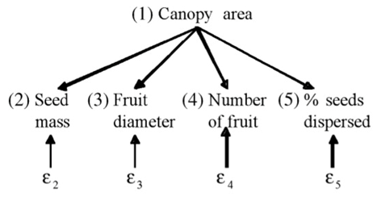
5.2 Directed Separation. Deriving the basis set
What is the basis set?
Dia ~ mass + canopy
mass ⏊ dia | (canopy)
mass ⏊ # | (canopy)
mass ⏊ %| (canopy)
dia ⏊ # | (canopy)
dia ⏊ % | (canopy)
% ⏊ # | (canopy)

Slide 19
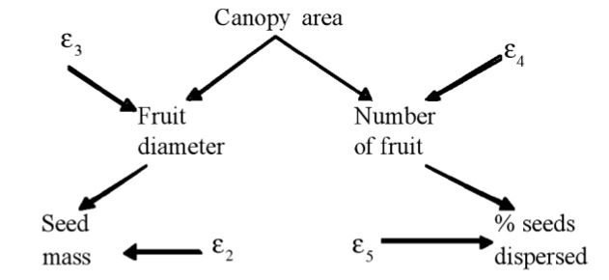
5.2 Directed Separation. Deriving the basis set
What is the basis set?
canopy ⏊ % | (#)
canopy⏊ mass | (dia)
dia ⏊ # | (canopy)
dia ⏊ % | (canopy, #)
mass ⏊ #| (dia, canopy)
mass ⏊ % | (dia, #)

Slide 20
5.2 Directed Separation. A note
Basis set generally excludes relationships among exogenous variables
x₁
y₁
y₂
x₂
x₁ ⏊ y₂ | (y₁)
x₂ ⏊ y₂ | (y₁)
x₁ ⏊ x₂

Slide 21
5.2 Directed Separation. A note
Basis set generally excludes non-linear components
x
y₁
y₂
x²
x ⏊ y₂ | (y₁)
x² ⏊ y₂ | (y₁)

Slide 22
5.2 Directed Separation. A note
Basis set generally excludes non-linear components
x₁
y₁
y₂
x₂
x₁ ⏊ y₂ | (y₁)
x₂ ⏊ y₂ | (y₁)
x₁ * x₂ ⏊ y₂ | (y₁)

Slide 23
5.2 Directed Separation. Fisher’s C
Summarize independence claims across basis set:
C = -2*∑ln(p_{i})
p_{i} = the p-values of all tests of conditional independence
p can come from many statistics
C has a χ²-square distribution with 2k degrees of freedom
k = # of elements of the basis set.

Slide 24
5.2 Directed Separation. Fisher’s C
What is p < 0.05?
You are likely missing some associations
You can reject this model
The way forward: adding links or different model structure? (look at d-sep tests)
To re-iterate, p ≥ 0.05 is GOOD

Slide 25
5.2 Directed Separation. Model selection
Fisher’s C can be used to construct model AIC:
AIC = C + 2K
K = # of likelihood parameters estimated (not to be confused with k)
Can be extended to small sample size:
AICc = C + 2K(n / (n – K – 1))

Slide 26
5.2 Directed Separation. Sample size
Since there is no global vcov matrix, the t-rule does not apply
Shipley suggests need only enough d.f. to fit each component model
Or, d-rule (Grace et al 2015):
d = # of samples / # of pathways
d ≥ 5
More is always better!

Slide 27
5.2 Directed Separation. A warning
Intermediate non-normal endogenous variables pose a challenge
y₁
x
y₃
y₂

Slide 28
5.2 Directed Separation. A warning
If normal, significance values are reciprocal
y₁
y₁
y₂
y₂
y₁ ~ y₂
==
y₂ ~ y₁

Slide 29
5.2 Directed Separation. A warning
If non-normal, significance values are not reciprocal because of transformation via link function
y₁
y₁
y₂
y₂
log(y₁) ~ y₂
≠
log(y₂) ~ y₁

Slide 30
5.3 Introduction to piecewiseSEM

Slide 31
5.3 piecewiseSEM.
piecewiseSEM: Piecewise structural equation modeling in R for ecology, evolution, and systematics
install.packages(“devtools”)
library(devtools)
Install_github(“jslefche/piecewiseSEM”)
# install.packages(“piecewiseSEM”)
library(piecewiseSEM)

Slide 32
Mediation in Analysis of Post-Fire Recovery of Plant Communities in California Shrublands
Five year study of wildfires in Southern California in 1993. 90 plots (20 x 50m), (data from Jon Keeley et al.)
32

Slide 33
5.3 piecewiseSEM. Keeley example
Create list of structured equations
Conduct d-sep tests (evaluate fit)
Extract coefficients
abiotic
distance
rich
hetero

Slide 34
5.3 piecewiseSEM. Store list of equations
abiotic
distance
rich
hetero
keeley = read.csv(“keeley.csv”)
modelList = list(
lm(abiotic ~ distance, data = keeley),
lm(hetero ~ distance, data = keeley),
lm(rich ~ abiotic + hetero, data = keeley)
)

Slide 35
5.3 piecewiseSEM. Evaluate fit
sem.fit(modelList, data = keeley)
$missing.paths
missing.path estimate std.error df crit.value p.value
1 rich ~ distance + ... 0.6404 0.1565 86 4.0933 0.0001 ***
2 hetero ~ abiotic + ... 0.0022 0.0017 87 1.3296 0.1871
$Fisher.C
fisher.c df p.value
1 21.86 4 0
$AIC
AIC AICc K n
1 41.86 44.645 10 90
d-sep tests
Fisher’s C
AIC

Slide 36
5.3 piecewiseSEM. Model tweaking
$missing.paths
missing.path estimate std.error df crit.value p.value
1 rich ~ distance + ... 0.6404 0.1565 86 4.0933 0.0001 ***
2 hetero ~ abiotic + ... 0.0022 0.0017 87 1.3296 0.1871
abiotic
distance
rich
hetero

Slide 37
5.3 piecewiseSEM. Store list of equations
abiotic
distance
rich
hetero
modelList2 = list(
lm(abiotic ~ distance, data = keeley),
lm(hetero ~ distance, data = keeley),
lm(rich ~ distance + abiotic + hetero, data = keeley)
)

Slide 38
5.3 piecewiseSEM. Evaluate fit
sem.fit(modelList2, keeley)
$missing.paths
missing.path estimate std.error df crit.value p.value
1 hetero ~ abiotic + ... 0.0022 0.0017 87 1.3296 0.1871
$Fisher.C
fisher.c df p.value
1 3.35 2 0.187
$AIC
AIC AICc K n
1 25.35 28.735 11 90

Slide 39
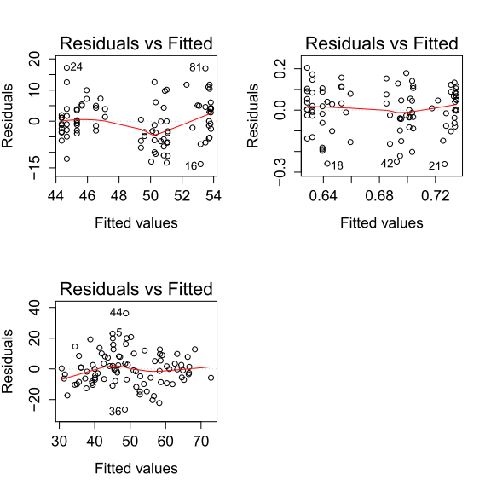
5.3 piecewiseSEM. Model assumptions
lapply(modelList2, plot, which = 1)

Slide 40
5.3 piecewiseSEM. Individual fits
sem.model.fits(modelList2)
Class Family Link n R.squared
1 lm gaussian identity 90 0.2113455
2 lm gaussian identity 90 0.1197074
3 lm gaussian identity 90 0.4700472

Slide 41
5.3 piecewiseSEM. Get coefficients
sem.coefs(modelList2)
response predictor estimate std.error p.value
1 abiotic distance 0.4597233 0.09466775 0.0000 ***
2 hetero distance 0.3459875 0.10001663 0.0008 ***
3 rich distance 0.3743419 0.09145170 0.0001 ***
4 rich hetero 0.2538814 0.08451308 0.0035 **
5 rich abiotic 0.2660206 0.08928820 0.0038 **

Slide 42
5.3 piecewiseSEM. Scaled coefficients
sem.coefs(modelList2, keeley, standardize = "scale")
response predictor estimate std.error p.value
1 abiotic distance 0.4597233 0.09466775 0.0000 ***
2 hetero distance 0.3459875 0.10001663 0.0008 ***
3 rich distance 0.3743419 0.09145170 0.0001 ***
4 rich hetero 0.2538814 0.08451308 0.0035 **
5 rich abiotic 0.2660206 0.08928820 0.0038 **
R² = 0.21
abiotic
0.46
0.27
0.37
distance
rich
R² = 0.47
0.35
hetero
0.26
R² = 0.12

Slide 43
5.3 piecewiseSEM. Compare to lavaan
modelList2.lavaan = sem.lavaan(modelList2, keeley)
lavaan::summary(modelList2.lavaan, rsq = T, standardize = T)
lavaan (0.5-20) converged normally after 37 iterations
Number of observations 90
Estimator ML
Minimum Function Test Statistic 1.810
Degrees of freedom 1
P-value (Chi-square) 0.178
Regressions:
Estimate Std.Err Z-value P(>|z|) Std.lv Std.all
abiotic ~
distance 0.400 0.081 4.911 0.000 0.400 0.460
hetero ~
distance 0.004 0.001 3.498 0.000 0.004 0.346
rich ~
distance 0.640 0.156 4.117 0.000 0.640 0.377
abiotic 0.523 0.170 3.079 0.002 0.523 0.268
hetero 33.401 10.760 3.104 0.002 33.401 0.256
R-Square:
Estimate
abiotic 0.211
hetero 0.120
rich 0.461

Slide 44
5.3 piecewiseSEM. Correlated errors
abiotic
distance
rich
hetero
modelList3 = list(
lm(abiotic ~ distance, data = keeley),
lm(hetero ~ distance, data = keeley),
lm(rich ~ distance + hetero, data = keeley)
)
sem.fit(modelList3, keeley, corr.errors = "rich ~~ abiotic")
sem.coefs(modelList3, keeley, corr.errors = "rich ~~ abiotic")

Slide 45
5.3 piecewiseSEM. Correlated errors
sem.coefs(modelList3, keeley, standardize = "scale",
corr.errors = "rich ~~ abiotic")
response predictor estimate std.error p.value
1 abiotic distance 0.4597233 0.09466775 0.0000 ***
2 hetero distance 0.3459875 0.10001663 0.0008 ***
3 rich distance 0.4843437 0.08737266 0.0000 ***
4 rich hetero 0.2894145 0.08737266 0.0013 **
5 ~~ rich ~~ abiotic 0.3058735 NA 0.0017 **
R² = 0.21
abiotic
0.31
0.46
0.48
distance
rich
R² = 0.42
0.35
hetero
0.29
R² = 0.12

Slide 46
5.3 piecewiseSEM. AIC comparisons
abiotic
distance
rich
hetero
abiotic
distance
rich
hetero

Slide 47
5.3 piecewiseSEM. AIC comparisons
abiotic
distance
rich
hetero
abiotic
0
0
distance
rich
hetero

Slide 48
5.3 piecewiseSEM. Fit new model
abiotic
distance
rich
hetero
modelList4 = list(
lm(hetero ~ distance, data = keeley),
lm(rich ~ distance + hetero, data = keeley)
)

Slide 49
5.3 piecewiseSEM. Evaluate fit
sem.fit(modelList4, keeley, add.vars = "abiotic")
$missing.paths
missing.path estimate std.error df crit.value p.value
1 hetero ~ abiotic + ... 0.0022 0.0017 87 1.3296 0.1871
2 rich ~ abiotic + ... 0.5233 0.1756 86 2.9793 0.0038 **
$Fisher.C
fisher.c df p.value
1 14.52 4 0.006
$AIC
AIC AICc K n
1 28.52 29.886 7 90
vs. AIC = 23.35

Slide 50
5.3 piecewiseSEM. Partial regressions
Isolate the independent effect of distance on richness:
Regress abiotic and hetero against richness (removing distance)
Regress distance against abiotic and hetero (remove rich)
Regression residuals of 1 against 2 (having removed effects of abiotic and hetero from both)

Slide 51
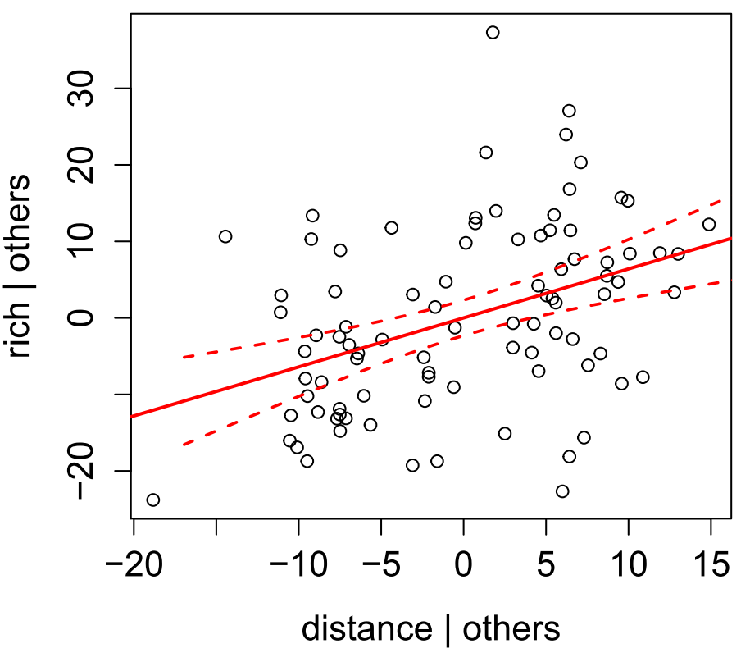
5.3 piecewiseSEM. Partial regressions
partial.resid(rich ~ distance, modelList2, keeley)

Slide 52
5.3 piecewiseSEM. Partial regressions
Useful for displaying trends, particularly with complex models where bivariate correlations are messy
Can be used for any multiple regression (single model or list)
Not applicable to simple regression (Y ~ X)

Slide 53


Slide 54
6.2 Mixed Models

Slide 55
6.2 SEM Example. Shipley 2009
Hypothetical dataset: predicting latitude effect on survival of a tree species
Repeated measures on 5 subjects at 20 sites from 1970-2006
Survival (0/1) influenced by phenology (degree days until bud break, Julian days until bud break), size (stem diameter growth)
Latitude
Degree days
Date
Growth
Survival

Slide 56
6.2 SEM Example. Shipley 2009
Two distributions: normal, binary (survival)
Random effects:
Site-only: latitude
Site and year: degree days, date
Site, year, and subject: diameter, survival
Latitude
Degree days
Date
Growth
Survival

Slide 57
6.2 SEM Example. What is the basis set?
Latitude
Degree days
Date
Growth
Survival
Date ⏊ Lat | (Degree days)
Growth ⏊ Lat | (Date)
Survival ⏊ Lat | (Growth)
Growth ⏊ Degree days | (Date, Lat)
Survival ⏊ Degree days | (Growth, Lat)
Survival ⏊ Date | (Growth, Degree days)

Slide 58
6.2 SEM Example. List of equations
Latitude
Degree days
Date
Growth
Survival
data(shipley2009)
modelList = list(
lme(DD ~ lat, random = ~1|site/tree, na.action = na.omit,
data = shipley2009),
lme(Date ~ DD, random = ~1|site/tree, na.action = na.omit,
data = shipley2009),
lme(Growth ~ Date, random = ~1|site/tree, na.action = na.omit,
data = shipley2009),
glmer(Live ~ Growth + (1|site) + (1|tree),
family=binomial(link = "logit"), data = shipley2009)
)

Slide 59
6.2 SEM Example. Evaluate fit
Latitude
Degree days
Date
Growth
Survival
sem.fit(shipley2009.modlist, shipley2009)
$missing.paths
missing.path estimate std.error DF crit.value p.value
1 Date ~ lat + DD -0.0091 0.1135 18 -0.0798 0.9373
2 Growth ~ lat + Date -0.0989 0.1107 18 -0.8929 0.3837
3 Live ~ lat + Growth 0.0305 0.0297 NA 1.0281 0.3039
4 Growth ~ DD + lat + Date -0.0106 0.0358 1329 -0.2967 0.7667
5 Live ~ DD + lat + Growth 0.0272 0.0271 NA 1.0038 0.3155
6 Live ~ Date + DD + Growth -0.0466 0.0298 NA -1.5620 0.1183
$Fisher.C
fisher.c k p.value
1 11.54 12 0.484
$AIC
AIC AICc K n
1 49.54 50.079 19 1431

Slide 60
6.2 SEM Example. Evaluate fit
Latitude
Degree days
Date
Growth
Survival
sem.model.fits(modelList)
Class Family Link N Marginal Conditional AIC
1 lme gaussian identity 1431 0.4766448 0.6932571 9166.9738
2 lme gaussian identity 1431 0.4083328 0.9838487 4694.9821
3 lme gaussian identity 1431 0.1070265 0.8364736 7611.3338
4 glmerMod binomial logit 1431 0.5589201 0.6291994 261.0824

Slide 61
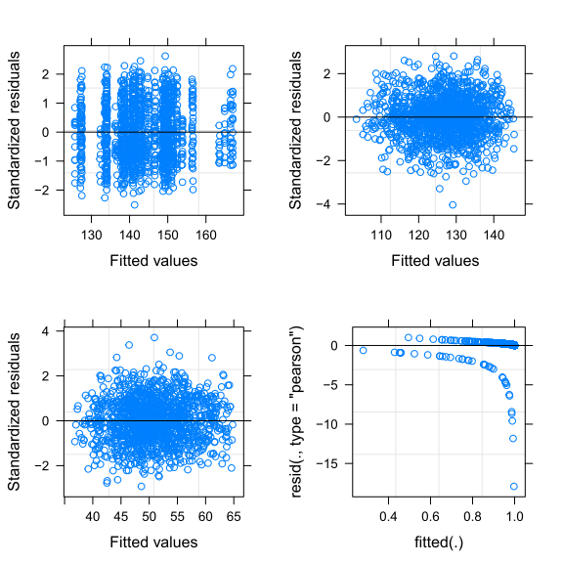
6.2 SEM Example. Evaluate fit

Slide 62
6.2 SEM Example. Evaluate fit
-0.70
-0.62
0.38
2.22
Latitude
Degree days
Date
Growth
Survival
sem.coefs(modelList, shipley2009, standardize = "scale")
response predictor estimate std.error p.value
1 DD lat -0.7014051 0.100258794 0
2 Date DD -0.6281367 0.006226838 0
3 Growth Date 0.3824224 0.033867469 0
4 Live Growth 2.2268600 0.373933623 0
Warning message:
In FUN(X[[i]], ...) :
Reponse ' Live ' is not modeled to a gaussian distribution:
keeping response on original scale

Slide 63
6.2 SEM Example. Alternate model
Date
Latitude
Degree days
Growth
Survival
sem.fit(modelList2, shipley2009)
$missing.paths
missing.path estimate std.error DF crit.value p.value
1 Date ~ lat + DD -0.0091 0.1135 18 -0.0798 0.9373
2 Growth ~ lat + DD + Date -0.1005 0.1114 18 -0.9019 0.3790
3 Live ~ lat + Growth 0.0305 0.0297 NA 1.0281 0.3039
4 Live ~ DD + lat + Growth 0.0272 0.0271 NA 1.0038 0.3155
5 Live ~ Date + DD + Growth -0.0466 0.0298 NA -1.5620 0.1183
$Fisher.C
fisher.c k p.value
1 11.03 10 0.355
$AIC
AIC AICc K n
1 51.03 51.626 20 1431
$AIC
AIC AICc K n
1 49.54 50.079 19 1431

Slide 64
6.2 SEM Example. Your turn…

Slide 65
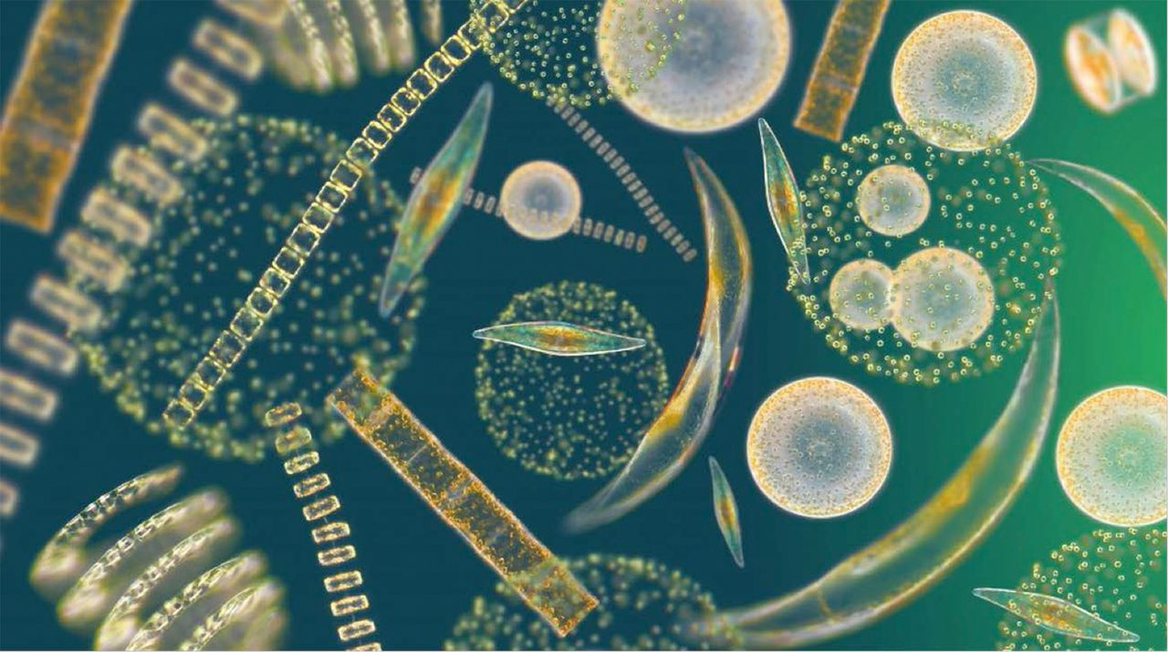
Yvon-Durocher et al (2015): Experimental warming on phytoplankton diversity and biomass
Warmed outdoor mesocosms for 5 years (!!) and measured phytoplankton diversity & biomass

Slide 66
6.2 SEM Example. Your turn…
Metabolic
Include random effect of Pond.ID!
Temp
Richness
GPP
Biomass

Slide 68
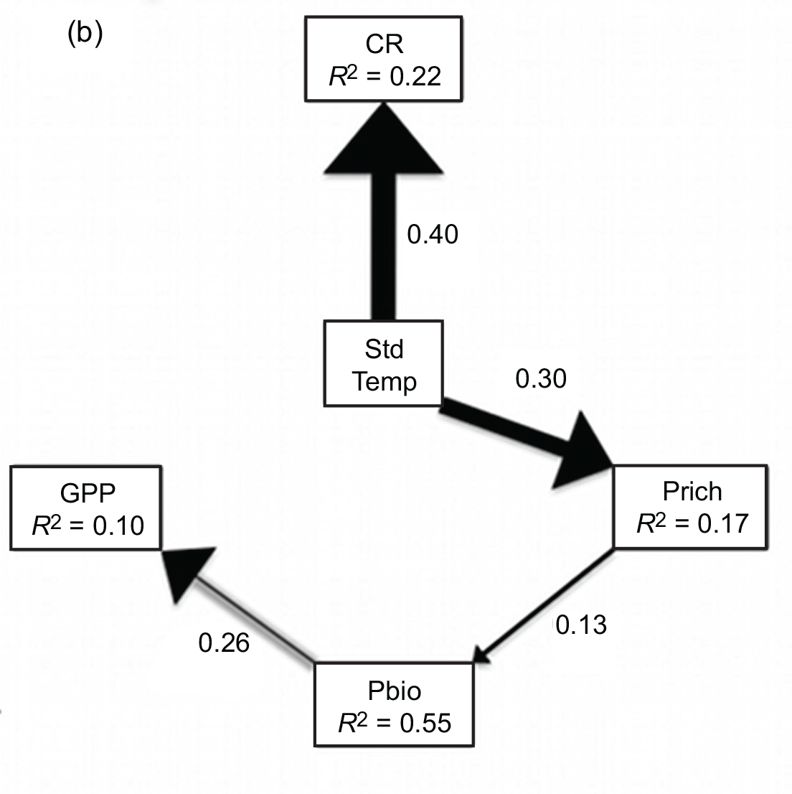
6.2 SEM Example. Your turn…
Metabolic
R² = 0.22
0.34
Temp
0.35
Richness
R² = 0.17
GPP
Biomass
R² = 0.10
R² = 0.55

Slide 69
6.2 SEM Example. Your turn…
Umm… what happened?
Try removing incomplete cases first: complete.cases
What is their mistake here?
Methods state: “with multiple measurements of variables made seasonally, nested within replicate mesocosms,” but then, “a path model as a set of hierarchical linear mixed effects models, each of which included hypothesized relationships between a response variable and a set of predictors as fixed effects and mesocosm ID as a random effect on the intercept.”
Play with the random structure?
Is it time to write a response?

